Slide 1
Present perfect tense настоящее совершённое время

Slide 3
Цель урока: научиться использовать настоящее совершённое время.
Задачи:
Повторить неправильные глаголы
Узнать слова спутники
построить форму образования Present Perfect Tense на основе правила.
Знать и использовать форму настоящего совершённого времени.

Slide 4
Last summer Alex went to London.
Yesterday I took photos.
I have already bought some souvenirs.
Last week we visited the Tower of London and saw black ravens.
Nick has just written his letter.

Slide 5
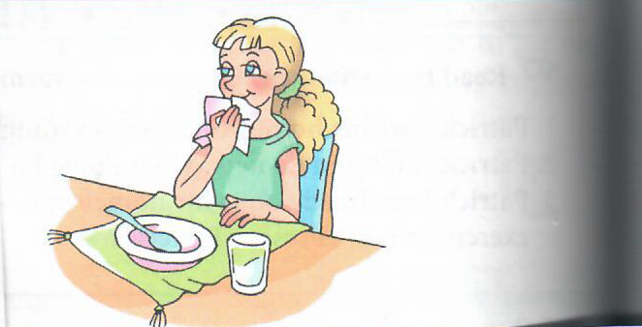
Susan
has
just
had
her
breakfast.

Slide 6
Dan has already written a postcard to
his friend.
Jason has never won the championship.
Mary has just finished the test.
Alice has recently bought some
souvenirs.
The tourist has already taken a photo of
the monument.

Slide 7
Homework
1. ex. 99, p.115
2. Написать 5 предложений о себе во времени Present perfect, нарисовать картинку к одному из предложений.

Slide 8
Yesterday somebody broke her pencil.
She has just broken her pencil.

